Slide 1




NEXT GEN EMPLOYABILITY PROGRAM
Creating a future-ready workforce
Team Members
College Name
Student Name :Reffy Pon Esther.R
Student ID :311121205048
Loyola ICAM College Of Engineering And Technology
Notes:
1

Slide 2

CAPSTONE PROJECT SHOWCASE
Project Title
Music Web Application using Django Framework
Abstract | Problem Statement | Project Overview | Proposed Solution | Technology Used | Modelling & Results | Conclusion

Slide 3
Abstract
This project outlines the development of a music web application using the Django framework. The application is designed to offer users a platform for exploring, streaming, and organizing music content. Utilizing Django's capabilities for rapid development and scalability, the application includes features such as user authentication, a dynamic database for storing music metadata, and an intuitive user interface for browsing and playing music tracks. Additionally, the application incorporates functionalities like user-generated playlists, search capabilities, and personalized recommendations based on user preferences. By leveraging Django's Model-View-Template architecture and its support for third-party libraries, the proposed music web app aims to provide a seamless and immersive user experience within the realm of digital music consumption.
Source :

Slide 4
Problem Statement
The problem at hand revolves around the inadequacies present in existing digital music platforms, prompting the need for a tailored solution. Users often face challenges with cluttered interfaces, unintuitive navigation, and limited feature sets on these platforms. Additionally, scalability and performance issues arise as user bases grow, hindering smooth functionality under heavy traffic loads. Content discovery remains a struggle, with users desiring personalized recommendations and effortless exploration of new music. To address these shortcomings comprehensively, there's a pressing need for a music web application developed using the Django framework. This solution aims to deliver a seamless user experience, advanced features like personalized recommendations and collaborative playlists, robust scalability and performance, and intuitive content organization tools, ultimately enhancing the digital music consumption experience for enthusiasts.
Source :

Slide 5
Project Overview
The proposed project entails the development of a music web application utilizing the Django framework, tailored to address the shortcomings prevalent in existing digital music platforms. The application seeks to offer users a seamless and intuitive platform for discovering, streaming, and managing music content. Key features include user authentication, a dynamic database for storing music metadata, and an interactive user interface for browsing and playing music tracks. Additionally, the application will incorporate advanced functionalities such as personalized recommendations, and social media integration to enhance the user experience. The project aims to leverage Django's Model-View-Template architecture and its robust ecosystem of third-party libraries to ensure scalability, performance, and ease of development. By focusing on delivering a comprehensive solution to the challenges faced by music enthusiasts, the project endeavors to create a compelling digital music consumption experience for users.
Source :

Slide 6
Proposed Solution
To address the existing challenges in the digital music streaming landscape and provide users with a personalized and intuitive music streaming experience, the following features have been designed and integrated into the Music Streaming Application using the Django framework:
1.Login and Sign Up:
User Authentication: The application provides secure user authentication, allowing users to create accounts and log in securely.
User Profile Management: Users can manage their profiles and customize their music preferences to receive personalized recommendations.
.
Source :

Slide 7
2.Search for Songs:
Basic Search Functionality: The application offers a simple search feature that allows users to search for songs by title, artist, or album.
3.Listen to Songs:
Audio Streaming: The platform facilitates seamless audio streaming, allowing users to listen to their favorite songs with high-quality playback.
4.Add Songs to Listen Later:
Save for Later Feature: Users can add songs to a 'Listen Later' playlist, enabling them to curate a personalized queue of songs to listen to at their convenience
5.Add New Songs:
Song Upload and Management: The platform enables users to upload and add new songs to the music library, providing them with a platform to share and discover new music..

Slide 8


Technology Used
Front-end
Back-end
Source :

Slide 9
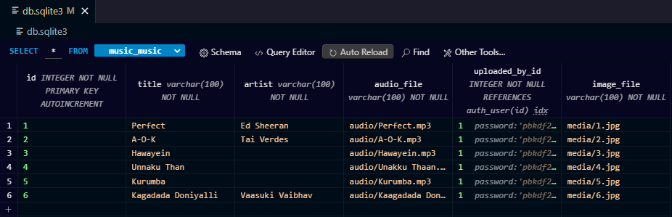
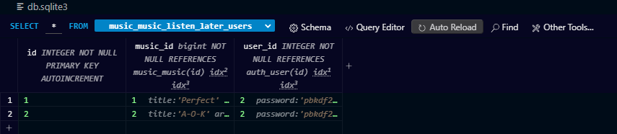
Modelling & Results

Slide 10
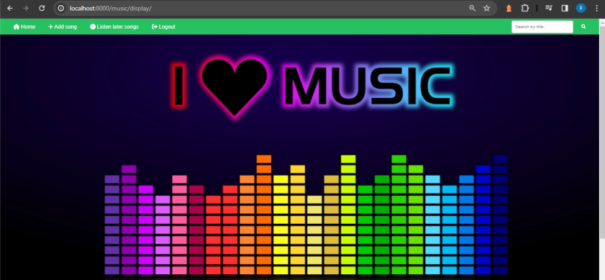
Homepage

Slide 11
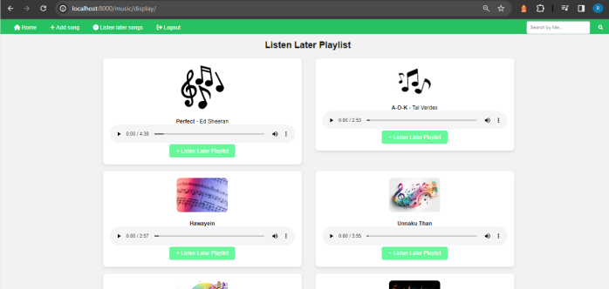
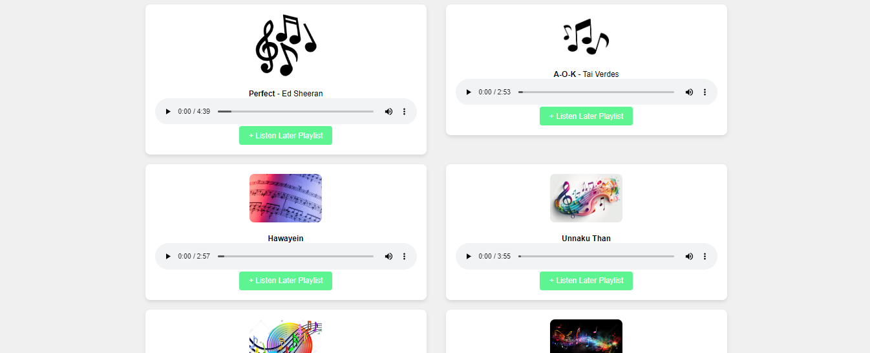
Listen Later Section

Slide 12
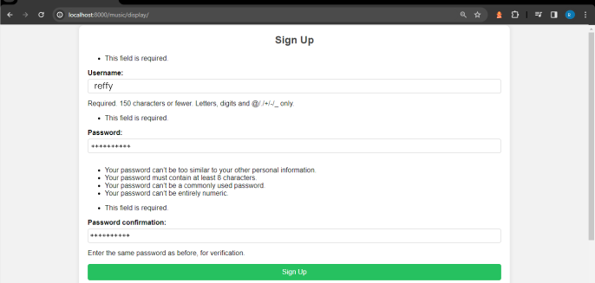
Sign Up-Page

Slide 13
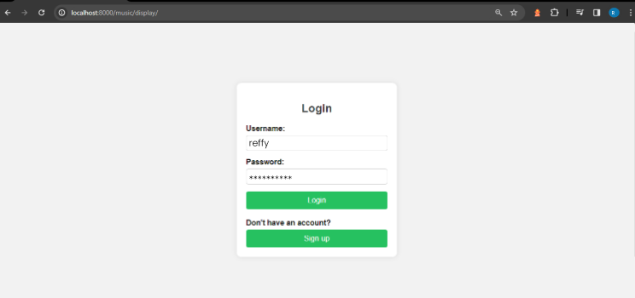
Login-Page

Slide 14
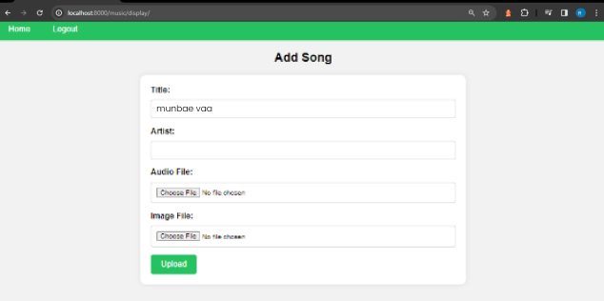
Add song-Page

Slide 15
Future Enhancements:
Looking ahead to future enhancements for our music web application built on the Django framework, there are several exciting avenues for development that promise to elevate the platform's functionality and user experience. One key area of focus will be the expansion of playlist management capabilities, allowing users to create collaborative playlists, schedule updates, and share their favorite mixes with friends and followers. Furthermore, personalized recommendations powered by machine learning algorithms will play a crucial role in guiding users to discover new music tailored to their preferences. Localization features, enhanced artist profiles, and curated music discovery tools will further enrich the user experience, making the platform more accessible and engaging for a global audience. Finally, exploring partnerships with music industry APIs will provide access to licensed content and valuable insights, ensuring the platform remains a leading destination for music enthusiasts. Through these future enhancements, our music web application will continue to evolve and thrive, offering users a rich and immersive music discovery and listening experience.

Slide 16
Conclusion
In conclusion, the development and ongoing refinement of our music web application using Django hold immense promise for delivering a robust and engaging platform for music enthusiasts. With its current features and functionalities laid as the foundation, future enhancements stand poised to elevate the user experience to new heights. As we move forward, it's imperative to remain attentive to user feedback, technological advancements, and industry trends to ensure that our platform stays relevant and resonates with our audience. By staying committed to innovation, user-centric design, and continuous improvement, we can cultivate a thriving community of music lovers and establish our platform as a premier destination for music exploration, enjoyment, and connection. Through collaboration, creativity, and a passion for music, we look forward to realizing the full potential of our music web application and shaping its future as a leading force in the digital music landscape.
Source :

Slide 17
Thank You!
Notes:
Thank You !!

